Slide 1
Handling Difficult Light Paths (virtual spherical lights)
Realistic Rendering with Many-Light Methods
Miloš Hašan
UC Berkeley

Slide 2
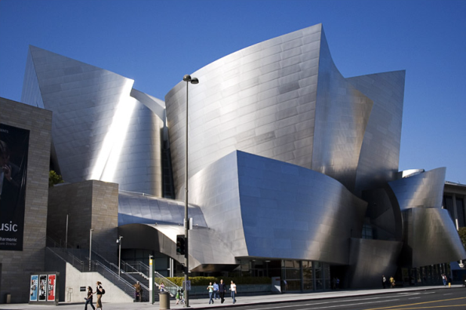
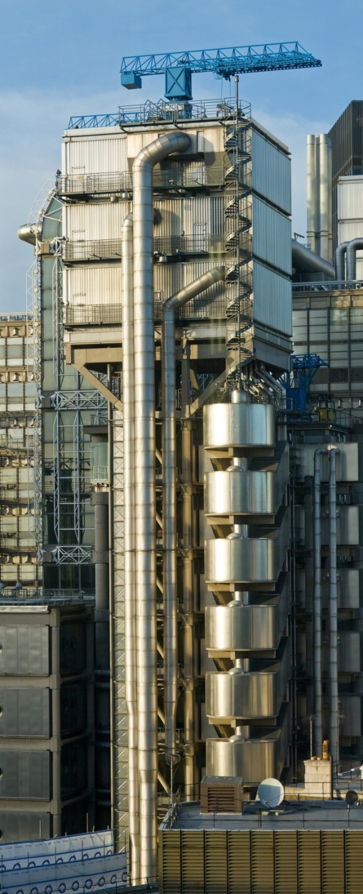
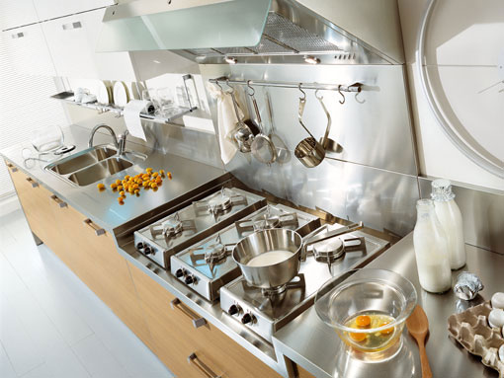
Glossy Inter-reflections
Notes:
In this part of the course, I will discuss virtual spherical lights, a technique that can reduce the energy loss problems encountered with standard formulations of virtual point lights.
One important application is architectural or industrial previews. They often contain a significant fractions of glossy materials, which create interreflections that cannot be neglected. These are somewhat extreme examples: their appearance is completely dominated by glossy inter-reflections. But they do present nice examples of scenes that will bring classic many-light algorithms to their knees.

Slide 3
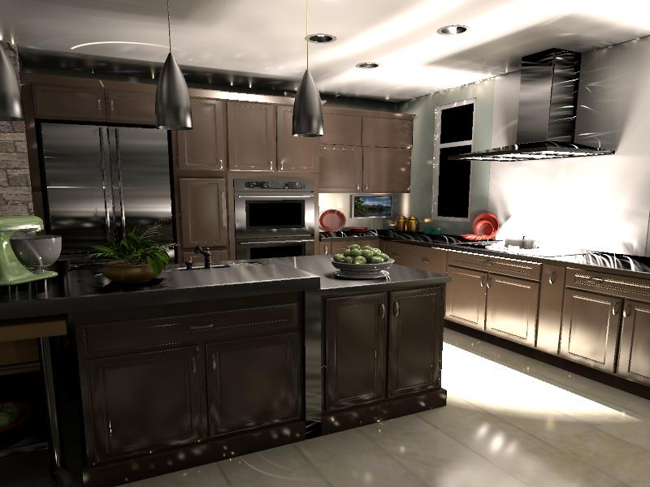
Glossy VPL Emission: Illumination Spikes
Notes:
If you render the scene with VPLs defined this way your will get an image with a lot of splotches. Each splotch corresponds to the spike in the emission distribution of a single VPL. For example, the streak on the ceiling is caused by a VPL located on a highly anisotropic glossy surface.
The common solution in instant radiosity is to ignore the glossy component of the BRDF at the light location which produces VPLs with very uniform emission distribution.

Slide 4
BRDF lobe at the VPL location
Glossy
Diffuse
Notes:
Here is what a VPL emission function should look like to give unbiased results: it is simply a combination of a diffuse and glossy BRDF lobe corresponding to the incoming direction of the VPL, multiplied by the cosine term.
We can easily see the issue – if the surface is highly glossy, the BRDF lobe will function as a „laser“ light that will create unacceptable spikes in random places around the scene. This problem is usually avoided by not including the glossy contribution of the VPL, which is clearly suboptimal.

Slide 5
Clamping
As || p – x || → 0, VPL contribution → ∞
p
spike!
x
x
Common solution: Clamp contribution
Notes:
However, this will not be sufficient. As we move the VPL location p and the shading point x closer and closer to the corner, the VPL contribution will go to infinity. This problem will be even worse if the BRDF at x is also glossy (remember, we only removed the glossy BRDF from the VPL location p).
The common solution to this is to clamp the VPL contribution to a user-specified maximum value. This not only removes illumination, but introduces another tricky parameter to the user, which is difficult to set automatically.

Slide 6
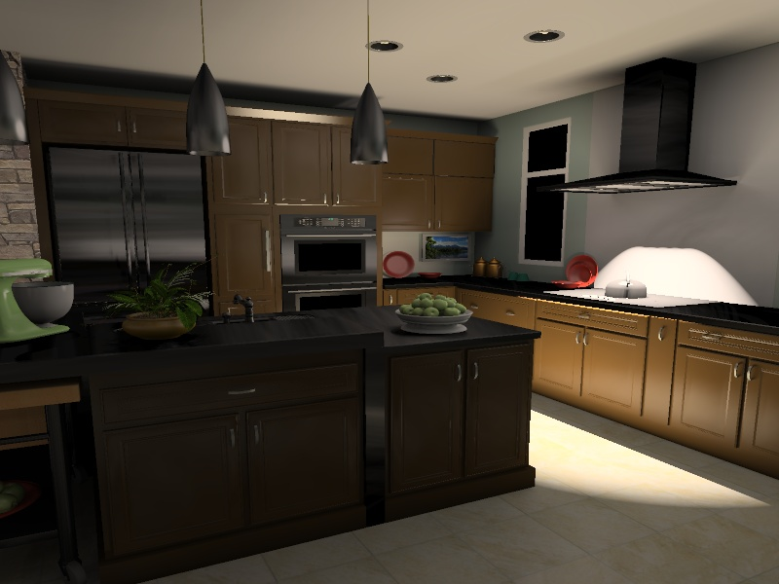
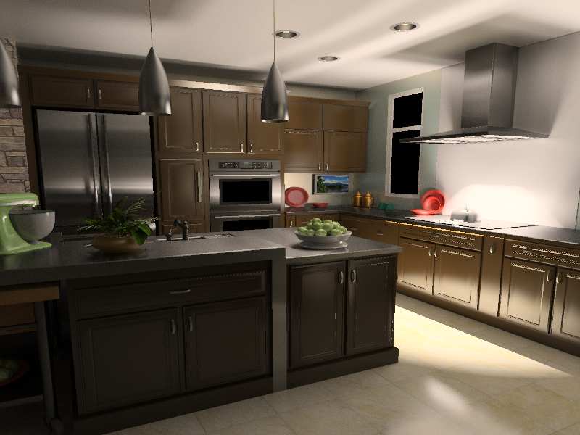
Energy Loss with Virtual Point Lights
Clamping causes energy loss
Reference
Notes:
In this kitchen scene, instant radiosity misses some important parts of light transport, which results in serious illumination loss on glossy surfaces, as you can see on the range hood or the counter.

Slide 7
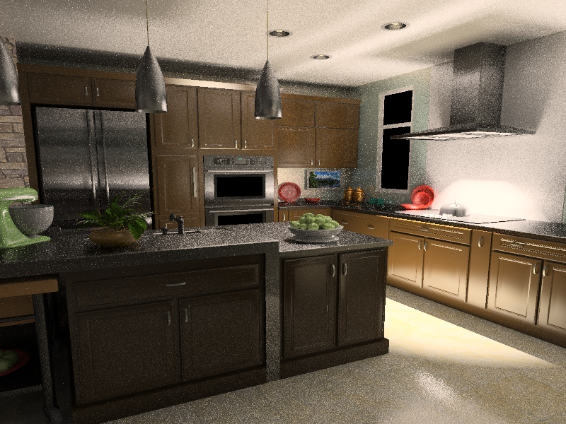
Clamping Compensation
Compute the missing components by path tracing [Kollig and Keller 2004]
Glossy scenes
As slow as path-tracing everything
Path traced compensation: 3.5 hours
Reference
Notes:
The illumination loss problem hasn’t been extensively discussed in previous work with the exception of the paper by Kollig and Keller, who propose to compensate for the missing energy by path tracing. Unfortunately, in glossy scenes, their compensation methods can be nearly as expensive as path tracing the entire image.

Slide 8
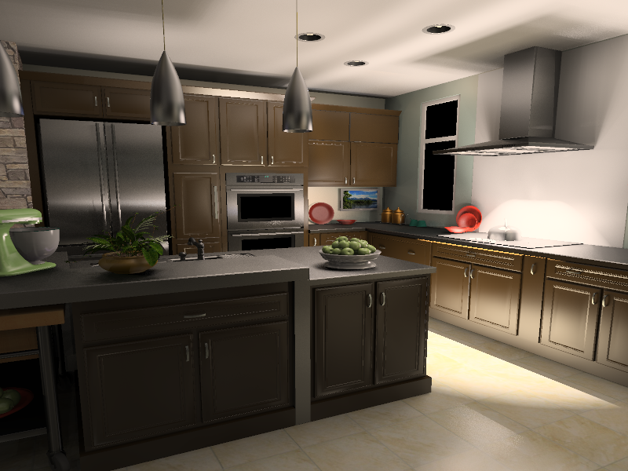
Virtual Spherical Light
Integration instead of point sampling
VSL: 4 minutes
Reference
Notes:
Our idea, on the other hand, is to prevent the illumination loss in the first place, rather than trying to compensate for it. We achieve this by introducing a new type of light, the VSL, that overcomes some of the problems of VPLs.
With this new type of light, we are able to render images very similar to the reference yet in much shorter time.

Slide 9
Recall: Emission Distribution of a VPL
Spike!
Notes:
As I mentioned, the glossy lobe of a VPL, if unclamped, will act as a “laser light” and create spikes on other surfaces.

Slide 10
What happens as #lights → ∞ ?
Spiky lights converge to a continuous function!
Notes:
This spike is actually “correct” in the sense that a superposition of many spikes will eventually clean up into a correct, smooth solution.

Slide 11
Idea: We want a “virtual area light”
Aggregate incoming illumination
Aggregate outgoing illumination
“Virtual area light”
Problem: What if surface is not flat?
Notes:
This suggests that we should look for a modified kind of virtual light that “aggregates” this illumination the ilumination, by considering a bundle of incoming light reflecting from a non-zero surface area and producing an outgoing bundle.

Slide 12
Expand Point into Sphere
Non-zero radius (r)
Integration over
non-zero solid angle
p
l
Ω
x
Notes:
More specifically, we will spread the light energy over the surfaces inside the sphere of radius r centered at the light position p. And the contribution of the light will be computed as an integral over the solid angle subtended by the sphere.
This can be seen as an analogy to photon mapping: A photon contributes to all surfaces within radius r, and an additional final gather operator uses the “splatted” illumination to light other surfaces.

Slide 13
Light Contribution
Non-zero radius (r)
Integration over
non-zero solid angle
p
l
Ω
x
Notes:
Let’s write down the formula for the contribution of such a light to the surface point x. We have the integration over the solid angle. The integrand is a product of the following terms: the cosine weighted BRDF at the surface, next, the BRDF at the point y n the vicinity of the light location. Finally, we have an indicator term that is zero for all the directions that correspond to surface point y outside the sphere. We normalize the integration by the expected surface area inside the sphere, pi*r^2, and multiply by the light flux.
To avoid this indicator term, we could define the light contribution as an integral over a disk area. Unfortunately, doing that re-introduces the infamous 1/dist^2 term and produces bad results (we tried it).

Slide 14
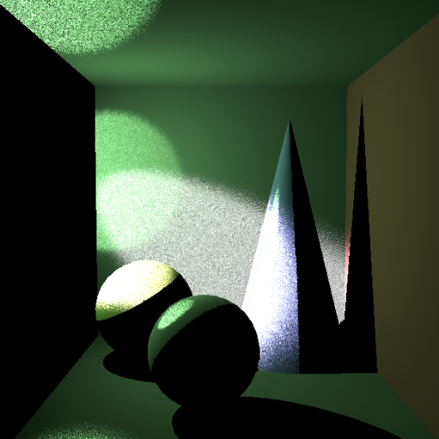
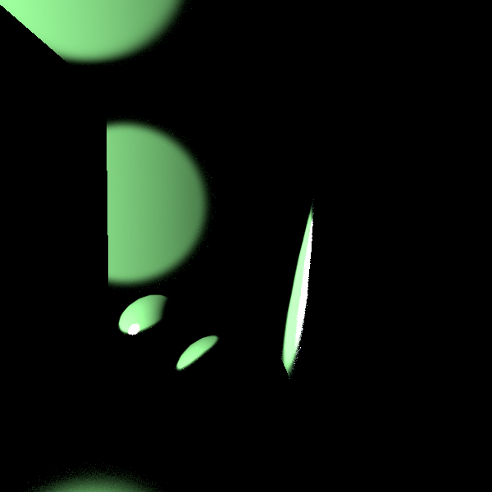
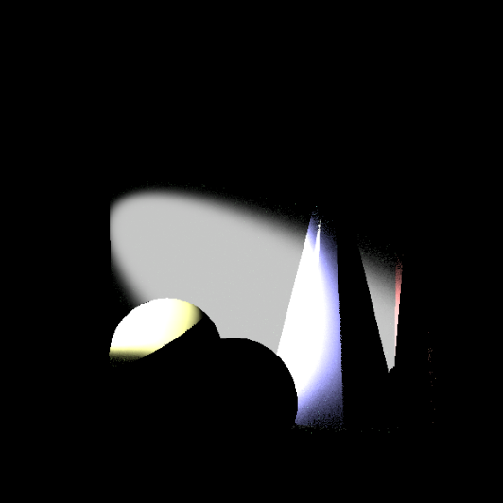
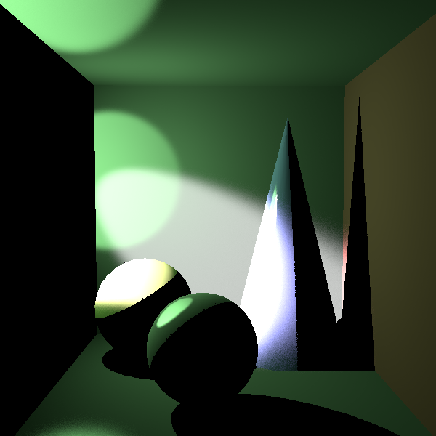
Computing the VSL integral
Stratified Monte Carlo in a shader
Cone sampling
BRDF 1 sampling
BRDF 2 sampling
Combined sampling
Notes:
As I mentioned, we can use stratified Monte Carlo to compute the VSL integral. One possible issue, in case one or both of the BRDFs involved have a glossy component, is that uniform sampling of the solid angle cone will not be well adapted to the integrand and lead to noise.
However, we can use multiple importance sampling – a variation of the same technique used in bidirectional path tracing. In addition to cone sampling, we can importance-sample either of the two BRDFs, and combine these estimators using the classic balance heuristic.
You can find the shader that computes the VSL integral online.

Slide 15
Results: Kitchen
Most of the scene lit indirectly
Many materials glossy and anisotropic
Path tracing:
316 hours (8 cores)
Clamped VPLs
34 sec (GPU) – 2000 lights
New VSLs:
4 min 4 sec (GPU) – 10000 lights
Notes:
Here‘s an example of the results we can get with VSLs. This scene is lit by mostly indirect light, through reflection from the shiny metallic surface on the right. There are several other highly glossy and anisotropic materials.
The image computed using the classic approach of clamping and diffuse VPLs looks clean but obviously dark, with some metals close to black.
In constrast, the VSL image is quite close to the path-traced ground truth, with a bit of blurring.

Slide 16
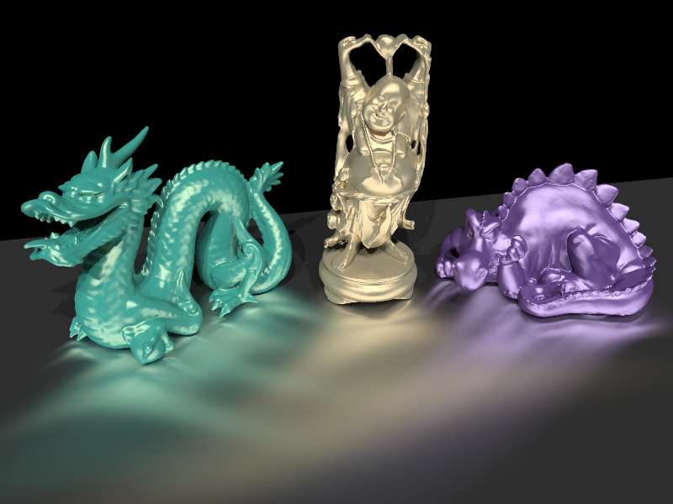
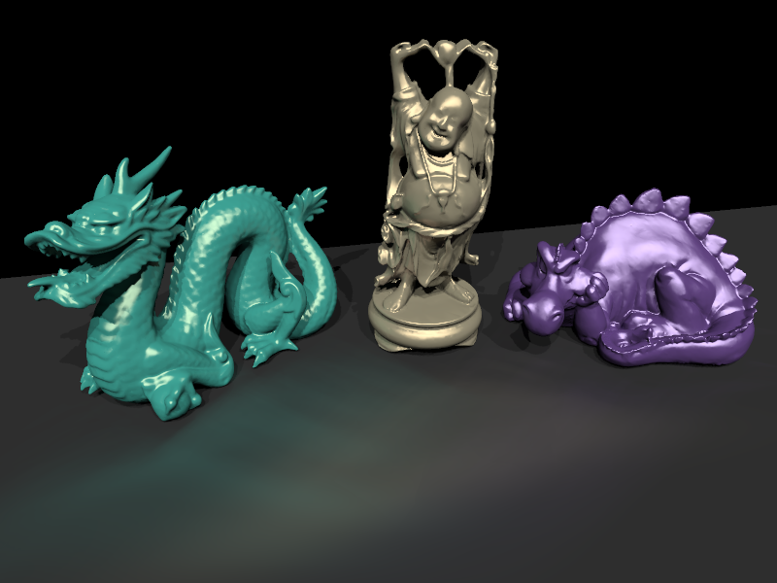
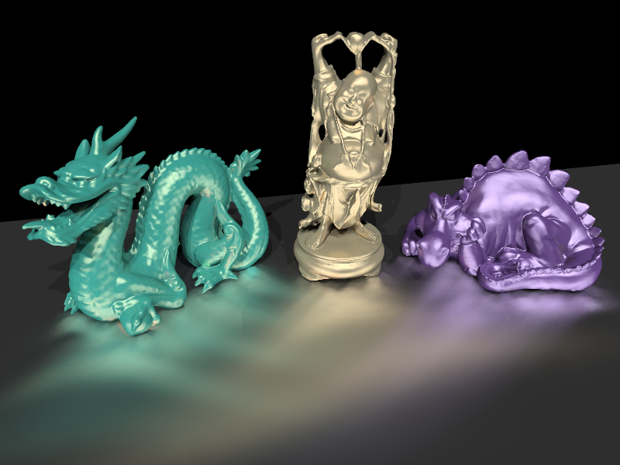
Results: Anisotropic Tableau
Difficult case
Standard VPLs capture almost no indirect illumination
Path tracing:
2.2 hours (8 cores)
Clamped VPLs:
32 sec (GPU) – 1000 lights
New VSLs:
1 min 44 sec (GPU) – 5000 lights
Notes:
This tableau consists of an anisotropic metallic plane with some objects, and 3 strong directional lights. This is a really bad case for clamping, which removes much of the reflection. On the other hand, VSLs capture it nicely, only slightly blurred.

Slide 17
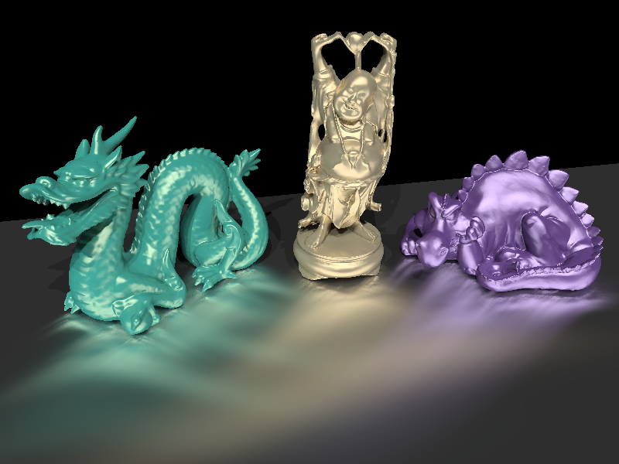
Limitation: Blurring
VSLs can blur illumination
Converges as number of lights increases
5,000 lights - blurred
1,000,000 lights - converged
Notes:
From the results it is apparent that the main limitation of VSLs is bias in the form of blurring. However, this is a very predictable effect, and in many cases may be acceptable. It is also consistent similar to photon mapping – results get more correct as VSL number increases (and therefore VSL radii decrease).
Jaroslav will later decribe the local light technique, which improves upon this limitation of VSLs, at the cost of somewhat higher complexity.

Slide 18
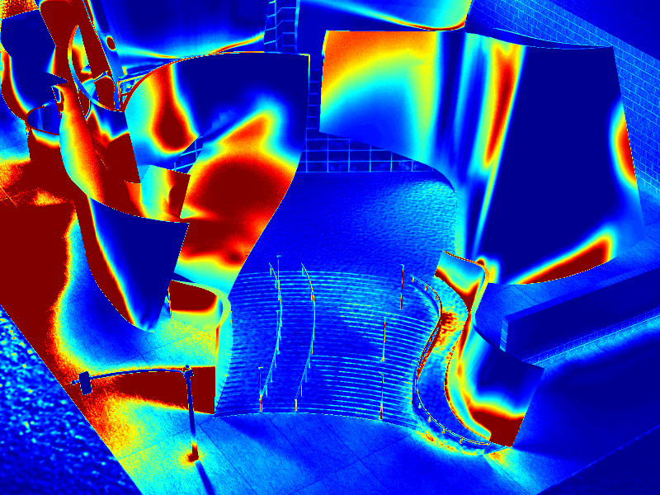
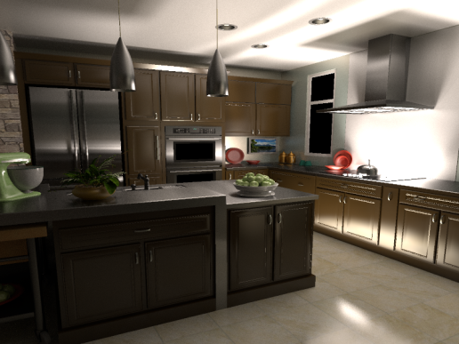
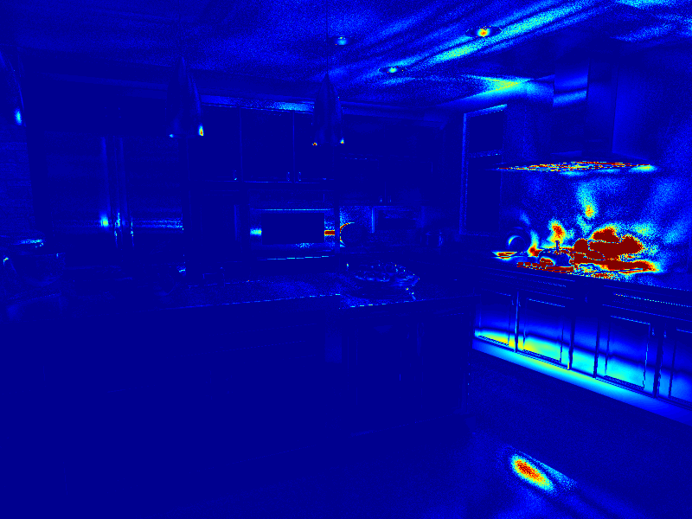
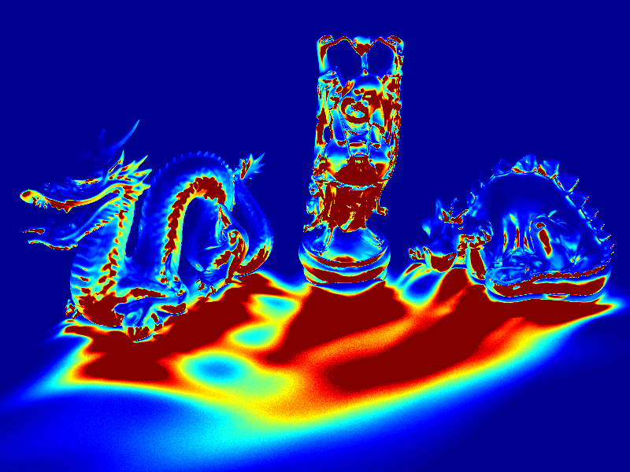
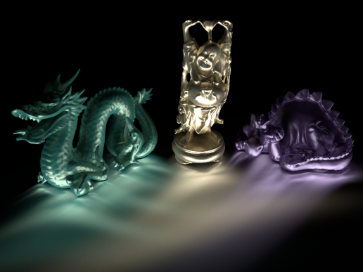
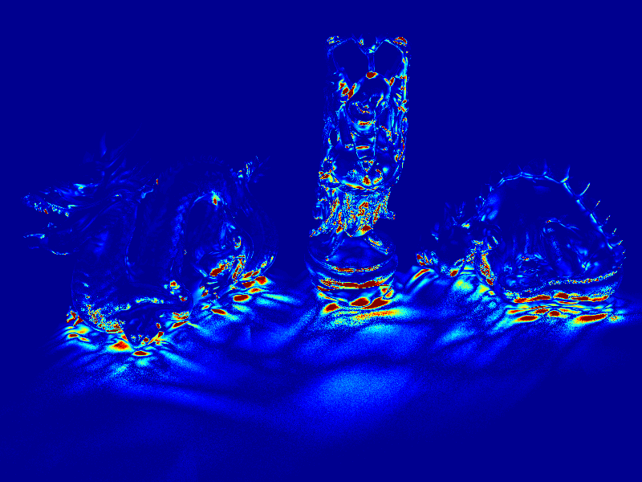
Error Images (Indirect Only)
clamped VPL error
ground truth
VSL error
Notes:
Despite the blur, the error is clearly decreased compared to clamped diffuse VPLs.

Slide 19
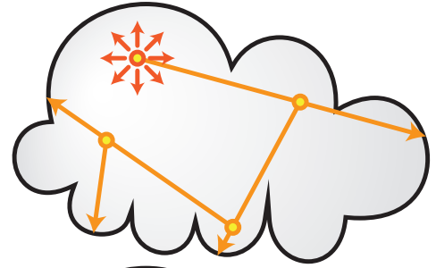
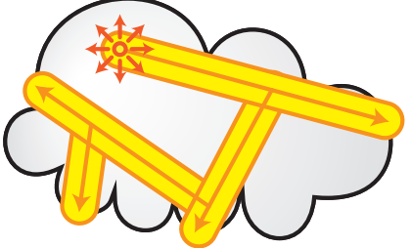
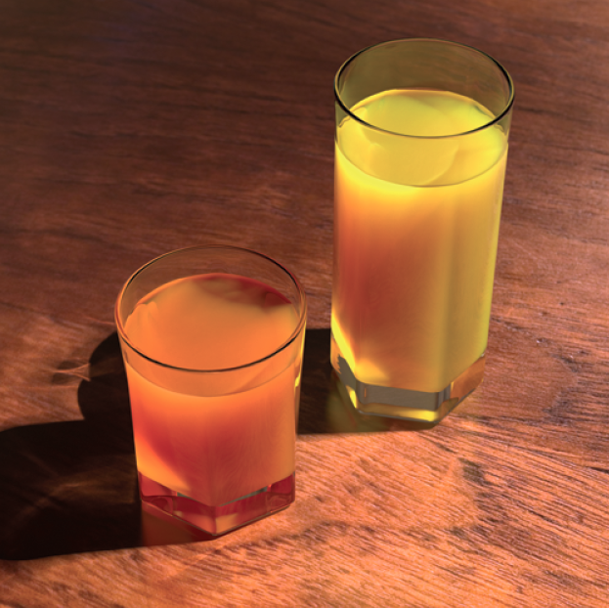
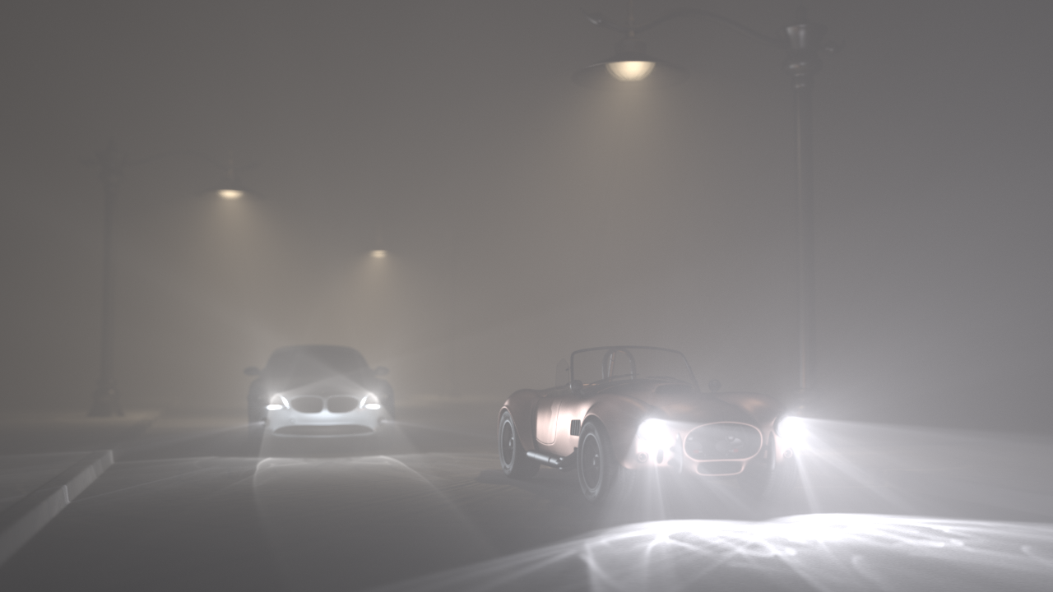
Ray/Beam Lights [Novák et al 2012]
virtual point lights
virtual ray lights
virtual beam lights
Notes:
Recently, similar VPL improvements have been introduced by Novak et al. in cases of volumetric media, leading to the concepts of virtual ray lights and virtual beam lights.

Slide 20
Progressive Clamping [Davidovič and Georgiev 2012]
Average separate runs of many-light method while increasing clamping constant
many averaged
many-light solutions
with progressive
clamping
path tracer
many-light
Notes:
I also wanted to mention a talk tomorrow about a different approach to counter the energy loss due to clamping: progressively increasing the clamping constant as more and more runs of a many-light algorithm are averaged.

Slide 21
Conclusion
Virtual Spherical Lights (VSLs)
Integration instead of point-sampling
No spikes, no clamping necessary
Improve practicality of many lights for real scenes

